Slide 1
Daniel for the
Biblically Inept
CIC 2020

Slide 2
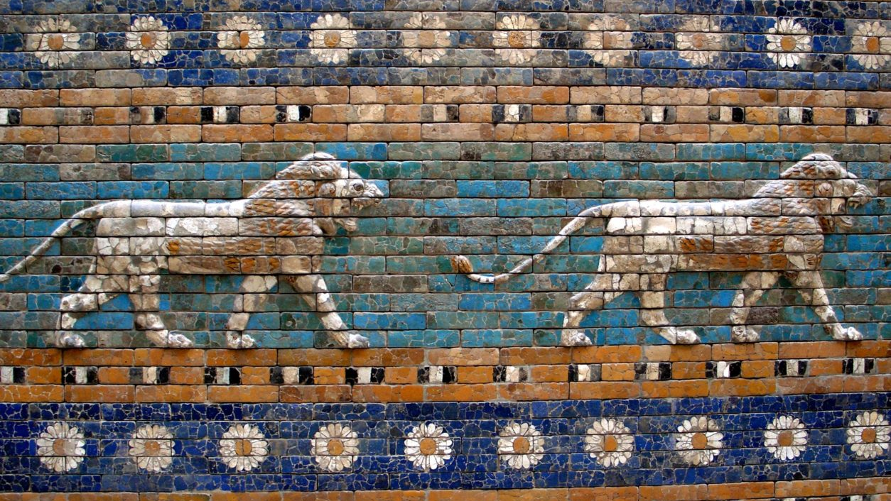
Ishtar Gate in Babylon from Nebuchadnezzar II

Slide 3
Week 1 – Daniel 1

Slide 4
Intro To Daniel
Chapter 1-6 Historic, 7-12 Prophetic
Theme is the Sovereignty of God –
    No matter who rules on earth, God has the final say
Daniel’s main focus is the Jews, peer of Ezekiel
    He ignores the church
Daniel’s prophesies about the end times often explained by other books in Bible. (Revelation)
Alexander read the book of Daniel(Josephus)
    Book included in Septuigant, Dead Sea Scrolls, Nabonidus cylinder

Slide 5
Get Started
God promised Hebrews that life of wickedness would produce consequences
God’s prophets warned the people of Judah repent or nation would be destroyed by Babylon Jeremiah 25:8-11
People’s ears tickled by false prophets-Jer 14:14
Judah’s wickedness comes to roost – Jer36:30,31

Slide 6
Who is Daniel
Daniel is Hebrew, royal family of Judah, born about 620 BC, about 13,14 when captured by Neb
Well educated, selected for more by Babylonians
Names – Daniel “God is my judge”, Belteshazzar “Whom Bel favors”, “Keeper of the treasures of the prince of Bel”

Slide 7
The attack on Jerusalem
3rd year of Jehoiakim reign (king of Judah)
Neb led the attack. Took a while (sync with Ezekiel 1:1-3)
Jeremiah places at fourth year but easily explained - full surrender happened later
Carried off the temple treasure put in pagan god temple – Blasphemy
God uses a pagan king to defeat Judah

Slide 8
Bring me the best
Ashpenaz- chief eunuch – head of the re-education program
Language, literature, philosophy – Indoctrination
    Perversion of godly teaching
    Hitler youth, Cultural revolution
Give them the best – Food & Wine
    Offered to pagan gods
Name changes to lose identity

Slide 9
Nope, Not me!
Daniel resolved not to defile himself with food and wine from the king.
Did not want to defile himself with the
breaking of the Law of God – Lev 7:19-27
This was a choice of huge proportion - Hebrews 11:25-29
Respected king enough to ask permission

Slide 10
Head of the Class
GOD gave knowledge and understanding
    Literature and language, Not re-education
    Understanding – Not so much what you know, but rather how you use it
GOD gave understanding of visions and dreams Eph 1:18
Presented & tested by the king – 10x capable than top people. Accepted into service – Ps 119:97-100

Slide 11
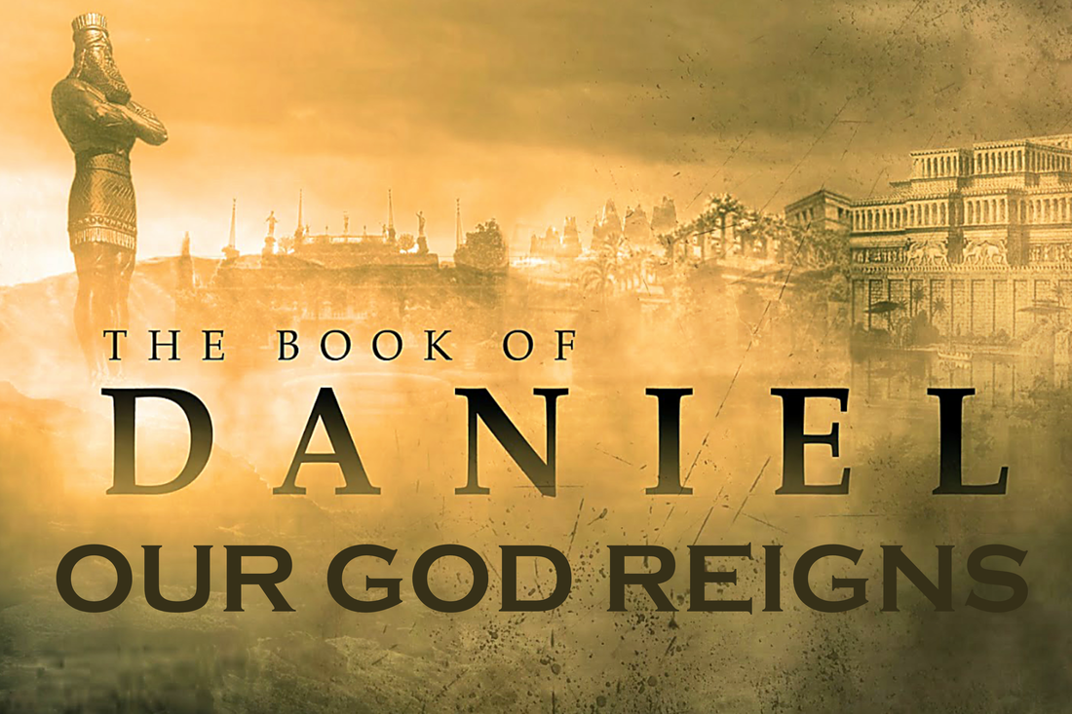
Daniel 2

Slide 12
The Dream Problem
Vs 1 – Daniel still a teenager. Timing is fuzzy because of policy of acting vs recognized king
King Neb has a dream and is so troubled, can’t sleep
Vs 2 – Neb calls his wise men
    Magicians – illusions, black magic (charms and spirits)
    Enchanters – chanters of evil spells and incantations
    Sorcerers – talk to dead, magic with evil spirits
    Astrologers – read horoscopes, stars to foretell future

Slide 13
The Dream Problem
Common practice throughout history
  Alexander, Pharoahs, Ceasars, Nancy Reagan, Hillary Clinton
Vs 3 Reiterates to advisors that he is troubled and wants to know the meaning
Vs 4 Astrologers want to know the dream so they can interpret (first verse written in Aramaic)
Vs 5 – King Neb demands they tell him his dream and the interpretation or he will destroy them or reward them

Slide 14
The Dream Problem
King had faith in astrology and augury (omens/signs) but not in the dream or the advisors
Vs 7 Beg again for the dream (fear of exposure as frauds)
Vs 8,9 King calls them out for trying to gain time and also for a misleading and wicked interpretation (fraud)
Vs 10,11 Astrologers – NO ONE CAN DO THIS, ONLY THE GODS CAN REVEAL IT and they do not live among men
    Admission of failure and fraud

Slide 15
The Dream Problem
Vs 12,13 King Neb orders them to be executed including Daniel and the three amigos
Vs 14,15 Commander of the guard goes to find Daniel and gives him explanation of what is going on
Vs 16 Daniel is bold enough to go to the king
    Leader – Stepped up (action)
    Asked for time – Needed to pray
    Vs 17 Called in his team (Matt 18:20)
    Vs 18 Joint effective prayer for mercy from God (James 5:16)

Slide 16
The Dream Problem
Vs 19,20 God reveals the dream to Daniel in a vision(divine revelation) and praises the one true God
God is:
    All knowing: 1 John 3:20, Ps 147:5, James 1:5
    All powerful: Job 42:1,2 , Matt 19:26
    All present: Ps 139:7-10, Jeremiah 23:24
Vs 21 God gives power and wisdom
    Ps 75:7, Prov 1:7

Slide 17
The Dream Problem
Vs 22 Daniel’s prayer recognized nothing is hidden with God
    Reveals deep secrets, reveals hidden things, source of revelation and enlightenment
Vs 23 Gives thanks to God for revelation and wisdom
Vs 24 Daniel beg for Arioch to not kill wise men and get an audience with king
    Compassion
    Pattern of asking for hard things

Slide 18
The Dream Revealed
Vs 25-28 Daniel presented as the solver
    Arioch takes credit for finding Daniel
    Prayer → Praise → Pursuit (Action)
  King asks Daniel if he can do it : Really asking Was your God able to help you? Did he hear your prayers?
  Daniel says no man can give the answer
  God can and has revealed the mystery

Slide 19
The Dream Revealed
Vs 28,29 Daniel drops the bomb that the dream is about things to come ( a great prophesy)
He also claims again that GOD is the revealer of mysteries
Vs 30 God revealed to Daniel –
    Not because he has greater wisdom
    To fulfill God’s purpose

Slide 20
The Dream Revealed
Vs 31-33 You saw an enormous statue
    Head – Gold
    Chest/Arms – Silver
    Belly/Thighs – Bronze
    Legs – Iron
    Feet – Partly Iron, Partly Baked Clay
    In order of value and weight

Slide 21
The Dream Revealed
Vs 34 Rock cut out not by human hand
    Supernatural
    Struck the feet (weak point) and smashed them
Vs 35 All the materials then are smashed into fine pieces like chaff on a threshing floor
    Indicative of judgement
      Ps 1:4-5, Jer 51:33+
    The rock becomes a mountain and fills the earth

Slide 22
The Interpretation
Vs 36 Daniel, the 3 amigos and God will reveal the int.
Vs 37,38 Reminds Neb of his great power and that it is directly from divine appointment (Dan 5:21)
Daniel reveals the Times of Gentiles / Age of Kingdoms
    First (Gold) Nebuchadnezzar
    Second (Silver) inferior to Neb
    Third (Bronze) rule over the whole earth
    Fourth (Iron) crush and smash all the others
      (Iron Clay) divided kingdom still with some strength

Slide 23
The Interpretation
First (Gold) Nebuchadnezzar – seems very clear that this Babylon reaching its height under Neb
Second (Silver) inferior to Neb – seems very clear that this is the Medes and Persians
Third (Bronze) rule over the whole earth – again this seems to clearly be the Greeks - Alexander
Fourth (Iron) crush and smash all the others – If one word described the Roman empire it would be CRUSH

Slide 24
The Interpretation
This gets us from Daniel to roughly the time of Christ
The “fifth” kingdom is the hot subject of debate
  Rome was originally split (285) by Diocletian into 2 kingdoms (east/west) - presumably feet
  The western remnant of the kingdom in 476 into 10 lands – presumably toes
      Franks, Huns, Visigoths, Ostrogoths, Heruli, Lombards, Anglo-Saxons, Suevi, Vandals, and Burgundians.

Slide 25
The Interpretation
Many are convinced that this represents the European Union, United Nations, NATO, Common Market Alliance Revived Holy Roman Empire, New World Order or something yet to be known.
We know 10 is significant.
    Daniel 7 – Beast has 10 horns
    Rev 13 – Beast has 10 horns (Rev 17:12)
Vs 43 people will be a mixture but will not be united

Slide 26
The Interpretation
Vs 44 In the times of the kings:
    God will set up a kingdom that will be never be destroyed
    It will end all kingdoms
    It will endure forever (Ps 72:11)
Vs 45 Rock is the work of God
Vs 46-49 Neb recognized Daniel and his God and the 3 amigos

Slide 27
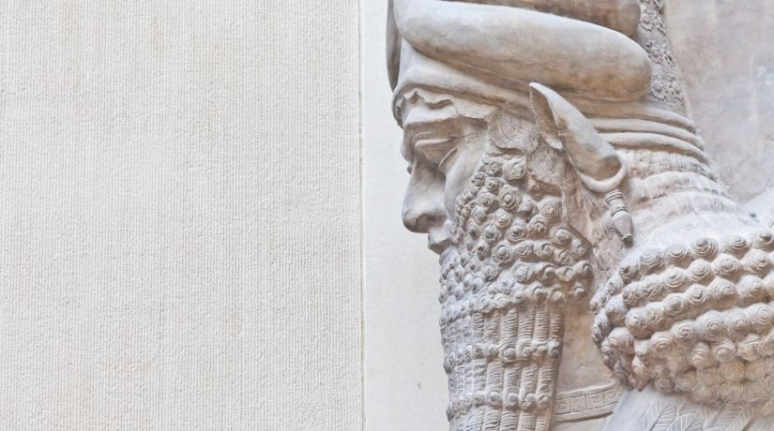

Slide 28
The Golden Statue
Daniel 3 begins 16-20 years after Chapter 2
Neb makes a statue of gold 90 feet tall 9 feet wide
    Outside of Babylon
    Seems that the original dream still troubled Neb
    Meant to be seen from a great distance
    Seems he thought he could overcome the dream and erect something

Slide 29
The Golden Statue
Summons all the government leaders (top seven levels) to attend a dedication service.
Believed he was trying to unite his vast kingdom religiously. If everyone bows to the same image they will essentially be united
    Tried before by Nimrod in the same spot
      Gen 10:8-10 (great grandson of Noah
      11:1-9

Slide 30
One World Worship Service
Vs 3 the rulers all gathered at the statue.
    Bible does not say whether Daniel was present assumed not
Vs4 The decree (similar to the antichrist)
    True religion is the love of God that comes from the purest heart pouring itself out in service and devotion
    Not forced (compulsion)
    Bow at the sound of music

Slide 31
One World Worship Service
Vs 6 – All who do not bow AND worship will be thrown into a blazing furnace.
Vs 7 all bowed and worshipped
2 Timothy 3:1-5 Form of Godliness
2 Timothy 3:12-17 Expect Persecution

Slide 32
Down with the Jews
Vs 8-12 Astrologers came forward to denounce the Jews
    Likely lingering anger or jealousy over the mercy shown 16+ years earlier
    No religions like competition
    Isaiah 54:17 Accusations against God’s servants are no weapon
    Buttered him up with fluff

Slide 33
Faithful Friends
Vs 13 Neb is furious
    Probably embarrassed by these prominent guys
    3 amigos called before the king
Vs 14-15 Say it isn’t so. I will give you another chance
    Reiterated the consequences
    One little bow will not hurt you (have you heard this before?)

Slide 34
Faithful Friends
Vs 16-18 Three Answers
  #1 We do not need to defend ourselves
      Already purposed in their hearts to obey God Acts 5:27-29
  #2 Our God is able to save us, He will rescue
      Trust - Isaiah 26:3,4, Ps 20:7
      They are answering Neb question about what God can save
  #3 Even if not saved, we will not bow
      Grace given when bowing at the true throne Heb 4:16

Slide 35
Into the Fire
Vs 19 – 7 times hotter anger and furnace
Vs 20-23 Thrown into fire 1 Peter 12-19 Rev 19:19-21
    Seems he was afraid their God was going to allow escape
    Used strong men and strong ropes
    Fully clothed
    The fire killed the guys who threw them in
    Standing for God will not keep you from persecution
      John 15:19

Slide 36
3 Guys and their God
Vs 24 Neb sees the guys alive in the furnace
Vs 25 Sees a fourth man and describes Him as looking like a “son of the gods”
    Preincarnate Christ (theophany)
      Burning bush Ex 3, Pillar of cloud/fire Ex 13, God with Moses, thunder, lightening, smoke Ex 19, The Transfiguration Mark 9, Holy Spirit tongues of fire Acts 2

Slide 37
3 Guys and their God
Vs 26 Neb calls them from the fire Isaiah 43:2, Rom 8:31
Vs 27 All gathered to gawk and see that fire had not :
    Burned their bodies
    Singed their hair
    Scorched their robes
    Left is smell on them

Slide 38
Recognition of the Supernatural
Vs 28-29 Neb praises the God of the 3 amigos.
    Recognizes salvation by their God (Psalms 68:20)
    Recognizes trust in their God
    Recognizes willingness to defy and to obey their God instead
    Recognizes that they would serve any other God
    Declares no one will say anything against their God or will be destroyed Declared that Yahweh saves!
Vs 30 Neb promotes the 3 amigos (reward for faith)

Slide 39
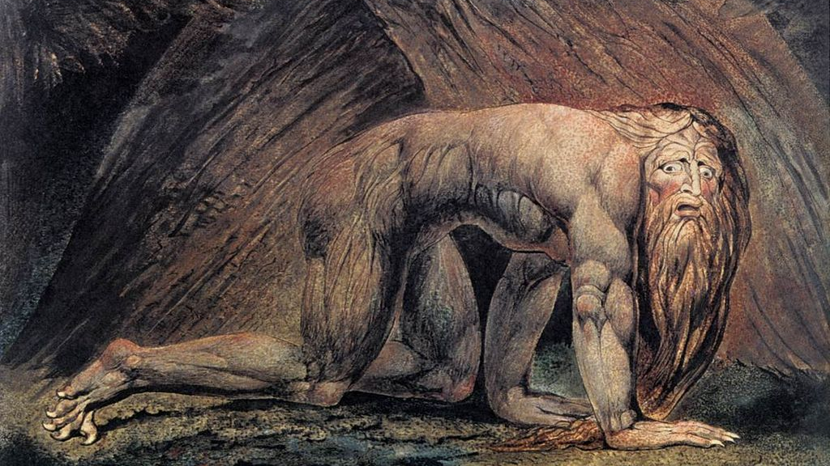
The madness of King Neb

Slide 40
Hear Me, Hear Me
Daniel 4 takes place about 40 years after taken captive
King Neb is in early 70’s
This section may have been a testimony from King Neb himself
About to see God deliver on a promise

Slide 41
Hear Me, Hear Me
Vs 1-3 Neb declares his affection and awe to the Most High God due to Signs (Evidence of things like Miracles/Covenants) Gen 9:12-13 and Wonders (Supernatural Events) Ex 3:20
Declares God’s kingdom as everlasting (Ps 145:13, Matt 25:46)

Slide 42
A New Man?
Vs 4 First Person recollection
  Sitting content in his palace home
    Seven wonders of the ancient world
      Pyramids of Giza
      Hanging gardens of Babylon (his home)
      Temple of Artemis at Ephesus
      Statue of Zeus at Olympia Greece
      Mausoleum at Halicanassus in Turkey
      Colossus of Rhodes
      Lighthouse of Alexandria on island of Pharos
  Content and Rich

Slide 43
Another Dream…
Vs 5 Terrifying Dream
Vs 6-7 brought in the wise guys again and they failed again (Act 16:16-19 slave girl possessed)
Vs 8 Daniel to the rescue
  The Spirit of the holy gods is in him
Vs 9 Declares Daniel the chief of the magicians and again affirms his indwelling by God

Slide 44
Another Dream…
Vs 10 A massive tree in the middle of the land
  Tree can symbolize a man Ps 1:3, Jer 17:8
  Tree can symbolize a nation Eze 31:3
Tree grew large and covered the earth and touched the sky
  Leaves beautiful and fruit plentiful and food for all
  Beast and birds all fed from it

Slide 45
Another Dream…
Vs 13 Messenger (watcher) sent from heaven (who was it – (Angel or Jesus)
Vs 14 Cut down the tree
    Tree would be cut down
    Branches cut off
    Leaves stripped
    Fruit scattered
    Animals flee
    Birds scattered

Slide 46
Another Dream…
Vs 15 Stump and roots bound with iron and bronze(a hedge – protection Job 1:10) remain in the ground
    Don’t disturb the grass around them
    Let him be watered with dew of heaven
    Let him live
    Dwell with the animals and plants
Vs 16 Let his mind changed from man to an animal
Seven times pass by for him Rev 12:14

Slide 47
God is the decision maker
Vs 17 Decision announced by messengers
The holy ones declare the verdict
To show the Most High God is sovereign over kingdoms of men
Gives the kingdoms to anyone he wishes
God sets rulers/kingdoms over the lowliest of men

Slide 48
The Interpretation
Vs 19-23 Declares the king the tree and his kingdom
Judgment and Grace (Rom 14:10-11, 2 Cor 5:10, Rev 20:11-15)
Obviously applies to King Neb, some illusion to 7 years of the antichrist

Slide 49
You are the man
Vs 25 You will be driven away from the people and will live with wild animals
    UNTIL you acknowledge the MOST HIGH is sovereign
Vs 26 the command to leave the stump means your kingdom will be restored to you when you acknowledge that Heaven rules
Vs 27 urging to Repent

Slide 50
God never forgets
Vs 28-29 One year later,
    Boasting about his position in life
    Boasting about his own glory
    God speaks – God will take the throne
    Gone in a word (Matt 23:12)
Vs 33 Turned into a human animal
Vs 34 Sanity returns after raising eyes to heaven
    Praises and honors MOST HIGH

Slide 51
God never forgets
Vs 36 kingdom restored and greater than ever before
Vs 37 King Neb is humbled and he praises and exalts God
    Everything God does is right
    All his ways are just
    All those who walk in pride he is able to humble

Slide 52
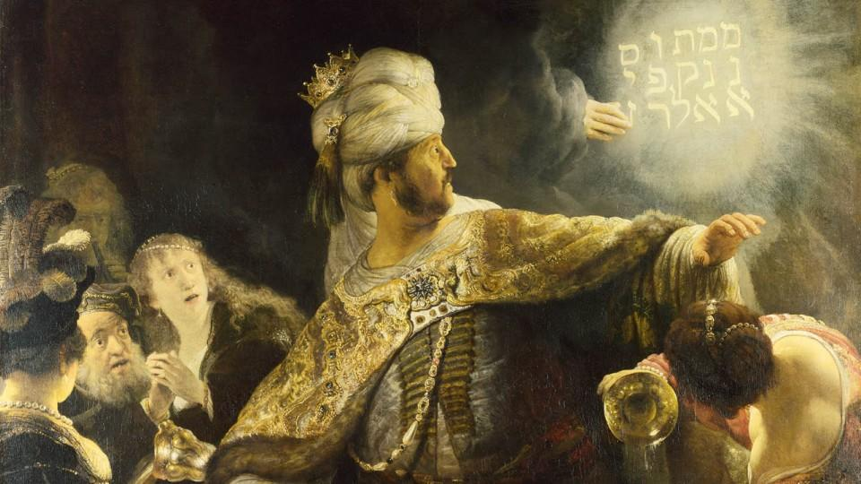
The Ultimate Party Trick

Slide 53
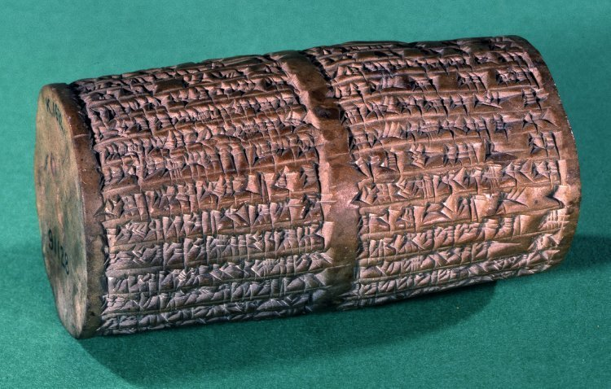
The Empire Stops
Chapter 5 represents the last night of Babylon’s existence, the last night of the empire of gold
Dan 2:32, 39 After you another kingdom will rise inferior to yours
Belshazzar has been hot topic of debate until this cylinder was recently found.
Nabodinus in his own words confirm Belshazzar is his son and ruling as co-regent
  [Nabonidus] entrusted the army to his oldest son, his firstborn, the troops in the country he ordered under his command. He let everything go, entrusted the kingship to him, and, himself, he started out for a long journey. The military forces of Akkad marching with him, he turned to Temâ deep in the west.
  As for me, Nabonidus, king of Babylon, save me from sinning against your great godhead and grant me as a present a lifelong of days, and as for Belshazzar, the eldest son—my offspring—instill reverence for your great godhead in his heart and may he not commit any cultic mistake, may he be sated with a life of plenitude.

Slide 54
The Empire Stops
20 year since chapter 4, Daniel is about 80
King Neb is dead
Lots of infighting in the royal family, and crown has changed hands several times
King Nabonidus is on the throne and his son Belshazzar is appointed regent and ruling at the time of chapter 5 while King Nab is repairing temples & engaging Medes and Persians
Daniel is not currently allowed in the palace

Slide 55
A Big Party
Vs 1 King Bel throws a monster party for a thousand nobles and drank
Medes (Cyrus) & Persians(Queen Mandan – Mede married to Cyrus) came together and defeated Nabonidus. Cyrus has the city under siege
King Bel thinks the city is invincible and throws a party

Slide 56
A Big Party
Vs 2-3 During his drinking he orders the sacred vessels from Israel brought in to drink from 2 Chron 36:11-21
Vs 4 as they drank wine, they praised the gods of gold, silver, bronze, iron, wood, stone
  Spitting in the face of the true God

Slide 57
A Big Hand
Vs 5 SUDDENLY hand writes on the plaster of the wall next to the lampstand and king watches it.
  This may be the golden lampstand from the temple
  Finger writing is same image as with Pharaoh and tablets being written on Ex 8:19, Ex 31:18, Luke 11:20, Ps 8:3, Isaiah 48:13, 64:8
Vs 6 King Bel goes pale and knees knocking and legs turn to jello

Slide 58
Bring in the Wise Guys
Vs 7 Calls for the wise guys
  Asks for someone to read the writing and tell the meaning
  Reward with riches and third in the kingdom (Neb, Bel, Interpreter)
Vs 8 The Wise Guys fail again – 1 Cor 2:14
Vs 9 King Bel is even more terrified

Slide 59
Get the Wise Man
Vs 10-12 The Queen (not likely King Bel’s wife) tells about Daniel and his former exploits and position within King Neb’s
  Showed the spirit of the holy gods (Dan 4:8,9,18)
  She says go get him
  He can do this – insight , intelligence, wisdom
Vs 13-14 Are you Daniel one of the exiles?, I have heard that the spirits of the gods is in you.

Slide 60
Get the Wise Man
Vs 15-16 The wise guys were brought in and could not explain it
Reasserts his promise to Daniel for riches and power
Vs 17 Keep your gifts, I will read and interpret Acts 8:17-20

Slide 61
Here Comes the Pain
Vs 18 GOD gave King Neb his sovereignty and greatness and glory and power 1 Sam 13:13,14
Vs 19 Because God gave him the authority, he could do what he wanted
Vs 20,21 But when his heart was arrogant and hardened with pride, he was deposed and stripped of his glory Prov 16:18, 1 Peter 5:5
Jeremiah prophecy 27:6,7

Slide 62
Here Comes the Pain
Vs 22 You have not humbled yourself even though you knew all of this 2 Peter 3:3-7
Vs 23 Instead you have set yourself against the Lord of Heaven
  Violated the vessels
  Worshipped other gods
  Did not honor God who hold in His hand your life
Vs 24 God sent the hand that wrote as a result

Slide 63
The Message
Vs 25,26 Mene – God has numbered the days of your reign and it is OVER Psalm 90:12
Vs 27 Tekel – You don’t measure up 1 Samuel 2:3 Job 31:6, Ps 62:9
Vs 28 Peres (Parsin) Your kingdom will be divided and given to the Medes and Persians

Slide 64
The Message
Babylon the great city –
  Outer wall 311 foot high, 87 foot thick, 56 miles long, 250 towers on top
  Surrounded by a moat/canal
  Huge gates
  Second wall
  River Euphrates flowed under the walls and supplied the city

Slide 65
The Invasion
Vs 29 Daniel rewarded
  False reward
  Purple
Vs 30 The king was killed that same night
  City was left unprotected because of party
  Troops dug a channel and them dammed up the river and essentially drained the river under the city

Slide 66
The Invasion
Vs 31 Darius the Mede tood over the kingdom at the age of 62

Slide 67
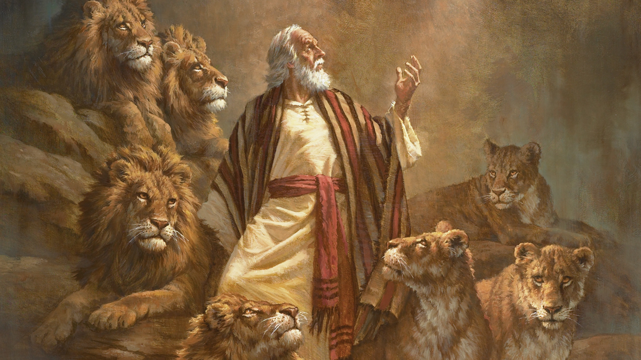
Daniel and the Lions

Slide 68
Daniel 6
Daniel is about 80
Darius (62 yrs old) is king and is sick
Vs 1-3 Darius appoints 120 satraps to rule
  3 admins over them and one was Daniel
  Daniel stands out among all the rulers
  God blesses Daniel like Joseph (Gen 41:39-44)

Slide 69
We have to get rid of this guy
Vs 4 The other rulers (satraps) and administrators were jealous of Daniel
  Set out to find fault
  Could not find any
  Trustworthy and not corrupt or negligent
    Paul – Acts 24:13-31
    Jesus – Luke 23:4
    Joseph – Gen 39-50
    Phil 2:15, 2 Tim 3:1-5

Slide 70
We have to get rid of this guy
Vs 5 We will never get rid of this guy
  Unless it has to do with the law of his God
  Like Rac, Shaq and Bennie Dan 3:8-12
Vs 6 Rulers go to the king, butter him up
  Disguised as angels of light 2 Cor 11:14
Vs 7 Suggest a law to prohibit prayer to any god other than the king Ps 62:4, Isaiah 45:5, 21, 22, 46:9
  Played on the ego of the king

Slide 71
We have to get rid of this guy
Vs 7
  Lied / exaggerated that even Daniel agreed to this.
  Matthew 26:59 Sanhedrin & chief priests were looking for false evidence against Jesus to put him to death
  Darius as a god for 30 days
  Penalty was death in the lions den

Slide 72
Back on His Knees
Vs 8 Make the decree immutable – no change
  Malachi 3:6
Vs 9 The decree was done
Vs 10 Daniel finds out about the law
  Goes home immediately
    Prays – 3 times daily to heaven
    Gives thanks
  Fully obedient – Eph 3:14, Ps 55:17, 1 Thess 5:17-19
  Civil Obedience - Rom 13:1-7

Slide 73
Tattlers on the loose
Vs 11 The men went as a group and found Daniel praying and asking God for help
  Not hard to catch
Vs 12 Go to the king and remind him about the law and the penalty and the immutability of the law
Vs 13 Drop the bomb that Daniel (the exile from Judah) has violated the law

Slide 74
The Results
The conspirators
  Guilty of anti-Semitism
  Tried to cause a rift between Daniel and the King
  Tried to put pressure on the King by showing that Daniel ignored the decree
  Reminded that the degree was in writing
King very distressed and tries to save Daniel

Slide 75
The Results
Vs 15 the gang comes to remind the King again that the law cannot be changed
Vs 16 The King gives the order and throws him in the lions den.
  Admonishes Daniel that he hopes that his God will rescue him 1 Thess 1:10, 2 Peter 2:9
Vs 17 Stone sealed the den and was sealed with Kings signet ring (like the tomb in Matthew 27:43)

Slide 76
No Sleep
Vs 18 The King goes to the palace and can’t eat or sleep Isaiah 58:4-7
Fasting is a spiritual event
  Sincerity before God (grief, humility, repentance, faith)
  Willing to exchange things they need or enjoy for a closer relationship with God
  Spritual things are more important to them than physical things
  Answer to prayer more important than own comfort

Slide 77
Back to the Lions’ Den
Vs 19 The king gets up early and runs back to the lions’ den
Vs 20 calls to Daniel
  Ask if God has rescued him
  John 15:7
Vs 21 Daniel answers O king live forever
Vs 22 God sent his angel and shut the mouth of the lion – Rom 4:20-21 , Jeremiah 32:17

Slide 78
Vengence is sweet
Vs 23 King is overjoyed and orders to get Daniel out
  Pulled out
  No wound
  Because he trusted in his God
Vs 24 The men who had falsely accused were thrown in to the den
  Including their families
  Before they reached the floor they were crushed

Slide 79
Prosperity
King Darius decrees that people must fear and reverence the God of Daniel (Dan 4:1)
  He is the living God, he endures forever
  Kingdom will not be destroyed, dominion will never end
  Rescues and saves, signs and wonders, rescued Daniel
Vs 28 Daniel prospered during the reign of Darius and the reign of Cyrus the Persian

